Slide 1
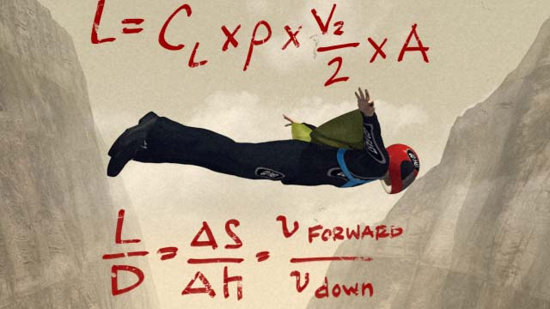
The Physics of Air
Weniger 151, January 11th 2015

Slide 2
He
N₂
C₃H₈
Why do some bubble float, some bubbles sink?
Demo #1: Kids blow bubbles, someone makes bubbles from a He tank and a propane tank

Slide 3
Air is made of tiny tiny tiny particles…
Demo #2: Open the scales of the universe website and zoom from human scale to atomic scale
Demo #3: Colorful juggling balls (balloons stuffed with dry rice) are used to represent gas molecules of different mass, do some juggling!

Slide 4
When you blow on your hand, you are feeling millions and millions of these tiny atoms colliding with your hand

Slide 5
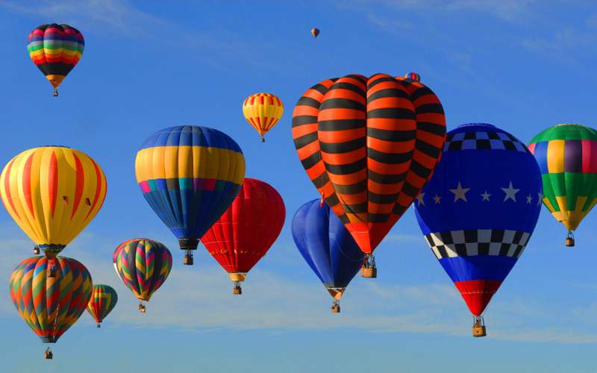
The starting point for explaining…
Things that float

Slide 6
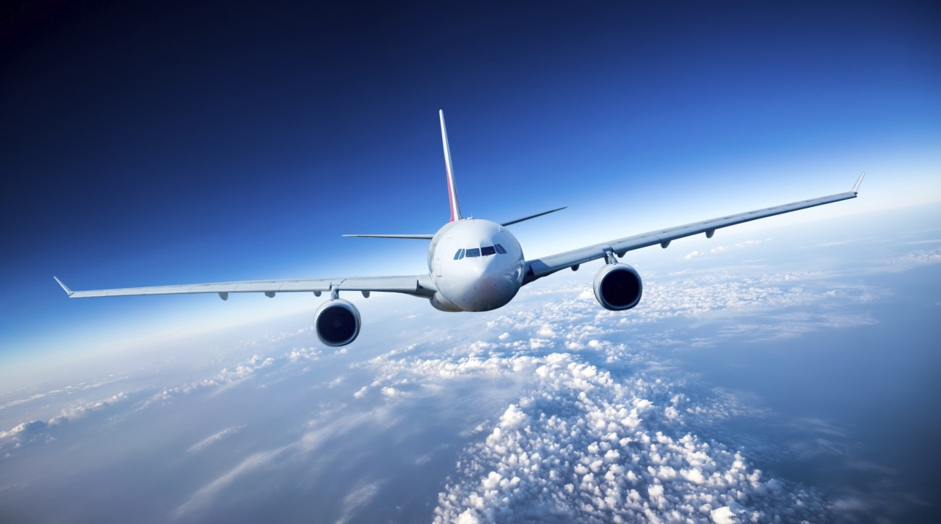
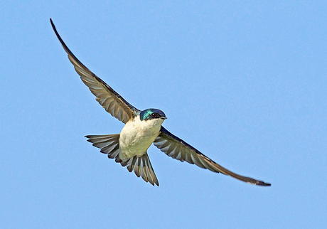
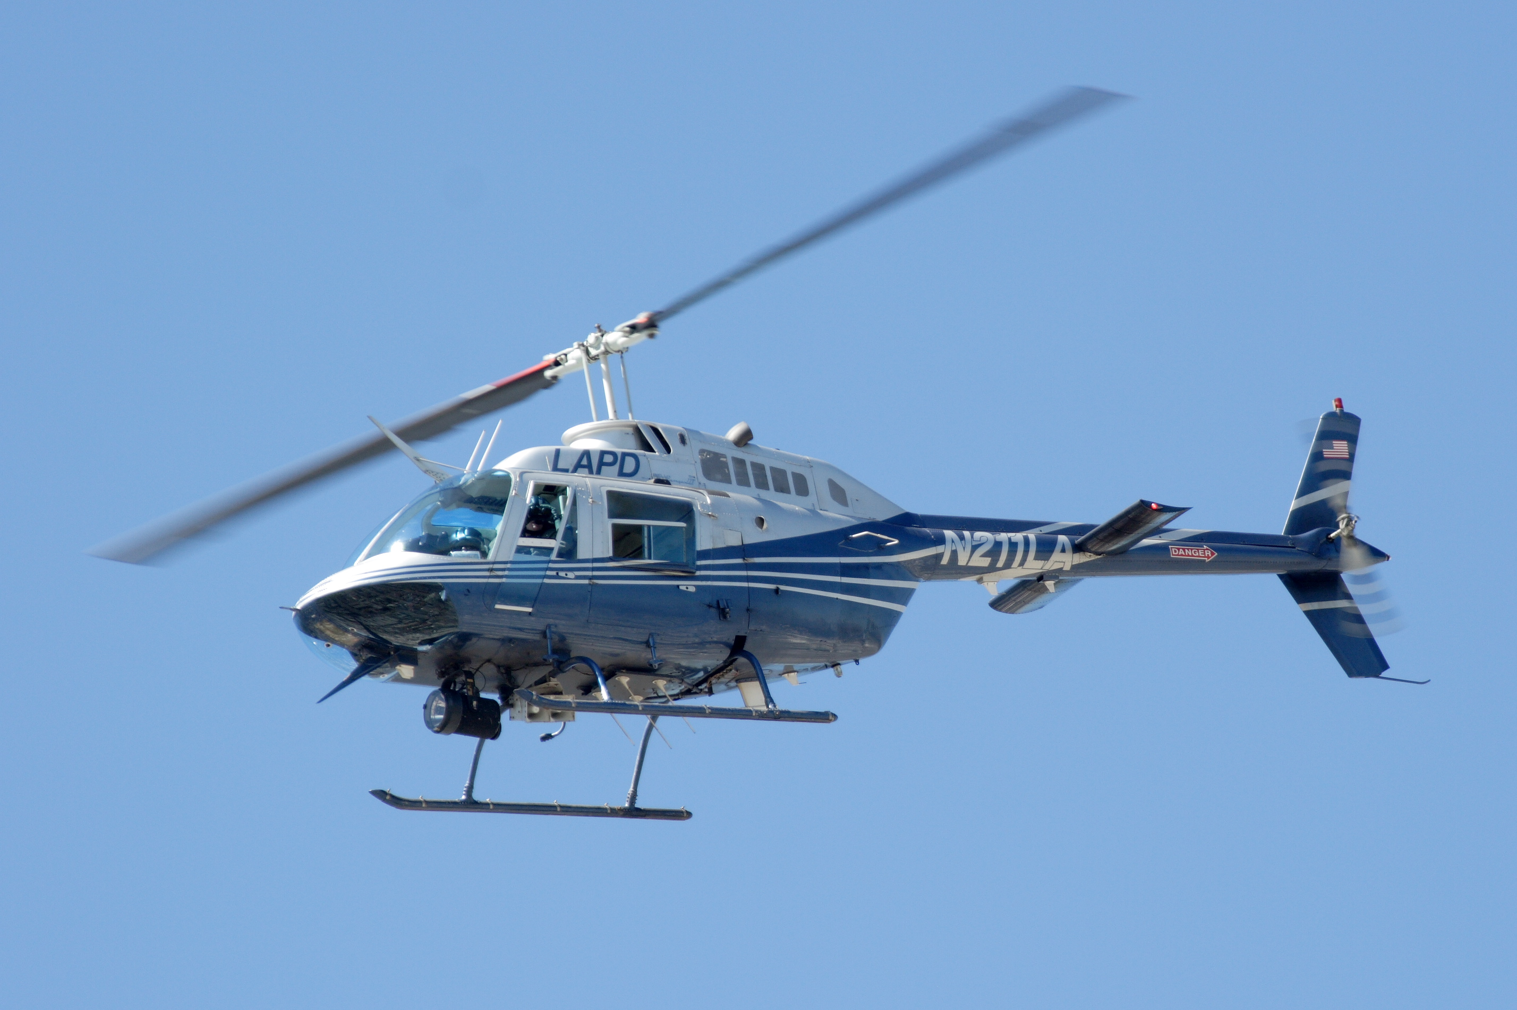
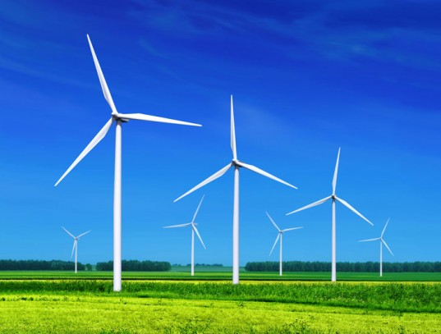
Things that fly
Wind energy

Slide 7
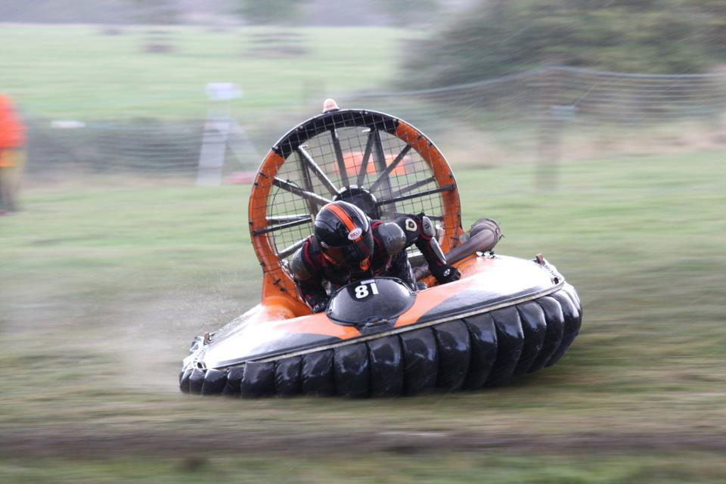
crazy adventure sports

Slide 8
The Physics of Air
Physics: Trying to answer questions like
* What makes things move?
* What variables control the system?
* What makes patterns and shapes emerge in natural systems?
Physics:
Explaining “what sets objects into motion?”
“where will objects end up?”
Working definition for today:
Carefully observing things move (like atoms and planets…)
Asking how and why.
What makes things move? How do I predict where things will move?

Slide 9
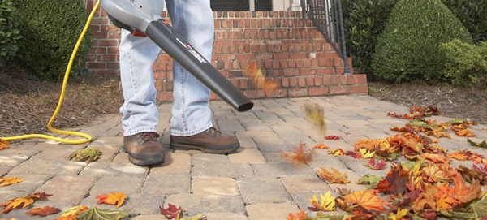
When I blow leaves, why do they move?
Demo #4: The “land yacht”. Use a cart that has minimal rolling friction. Give it a “sail”. Blow the cart across the room with a leaf blower. Now do the same thing by throwing the colorful juggling balls into the sail. Discuss the equivalence. In both cases we transfer momentum from high velocity particles (air molecules or juggling balls).

Slide 10
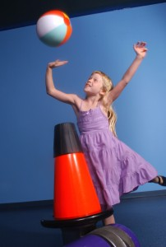
Demo #5: Make a beach ball float in the airstream of the leaf blower

Slide 11
How hard can I push something using air?
Time for a physics equation!
(experiment to validate the physics equation)
Demo #6: Measure the velocity of air coming out of the leaf blower. Do a back of the envelop calculation to estimate the force exerted by the air onto a sail. Discuss the units that I use to measure things like velocity and air density. Verify the calculation by attaching a sail to a Newton meter. The force will be a couple Newtons. Discuss the role of math. Discuss how physics predicts relationships between quantities that have different unit (e.g. relationship between air velocity and force).

Slide 12
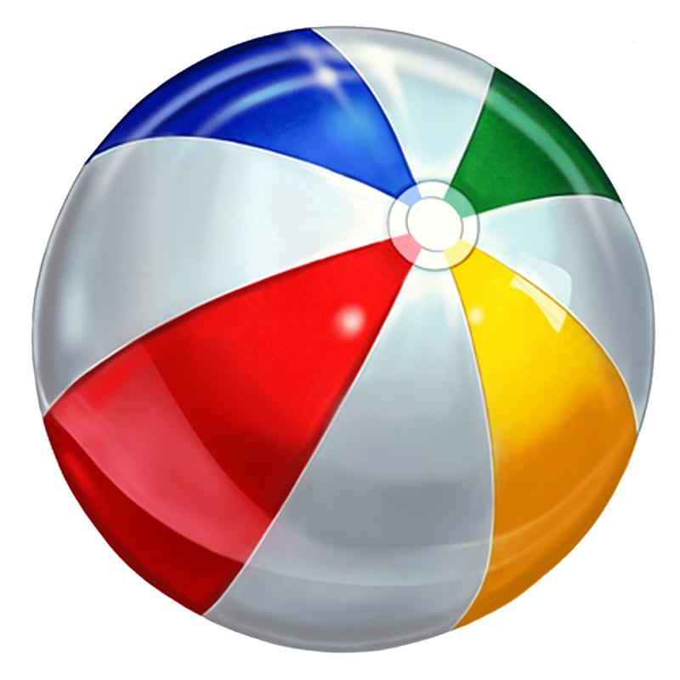
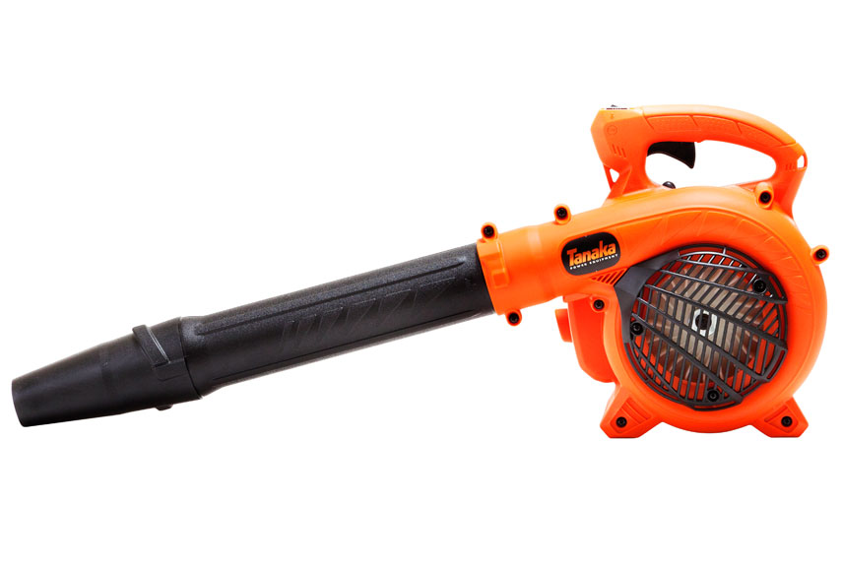
Demo #7: Use a Newton meter to see how much force it would take to lift a 5-year-old kid (the kid can hang on the Newton meter). The leaf blow gives 2 N… is it enough?

Slide 13
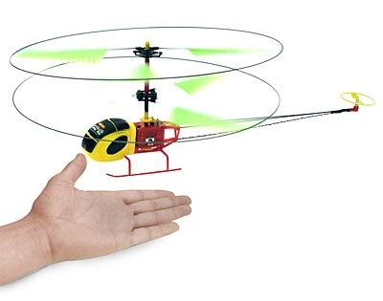
Air goes down, helicopter is pushed up
Demo #8: The toy helicopter is much lighter than a kid. In this case, blowing air downward gives enough force. Pilot a toy helicopter around the room. Let people feel the down draft.

Slide 14
Flying into the air from the recoil of air molecules

Slide 15
Floating on a bed of invisible air molecules
Demo #9: If we can’t fly like a helicopter… what’s the next best thing I can do with a leaf blower?
Give a kid a ride on a homemade hoverboard. Everyone else gets a turn at the end of the event.

Slide 16
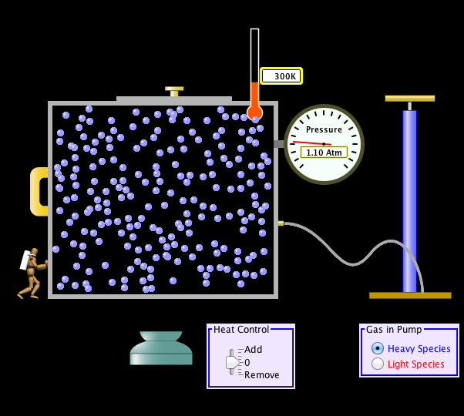
Molecular kinetics gas simulation module
Demo #10: Explain how the hover board worked using this PHET simulation. A small excess of air molecules in the chamber increases the pressure.

Slide 18
What about hot air balloons?
The best way to understand something is to build it…
Activity #1: Teams of two kids with one parent overseeing. Build hot air balloon.

Slide 19
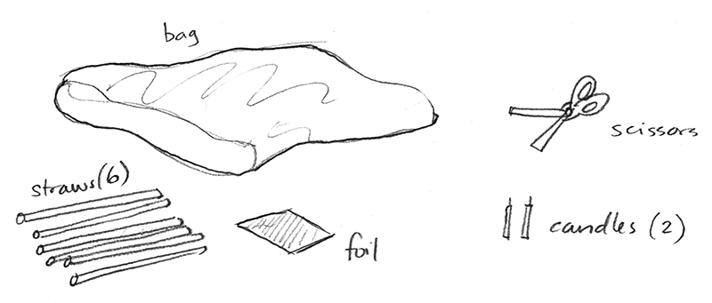
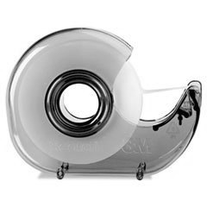
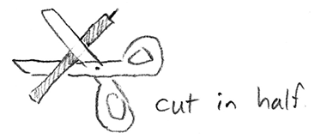
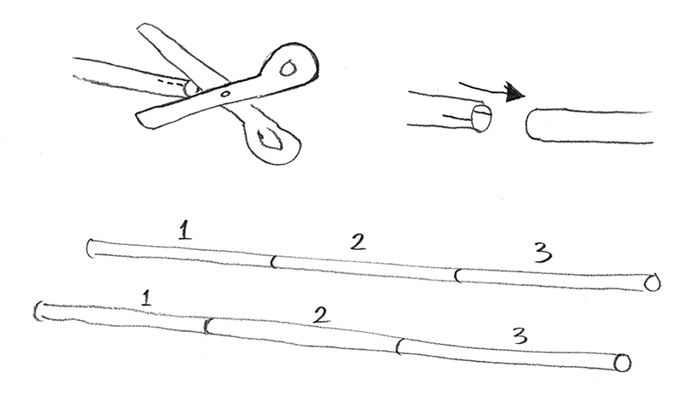
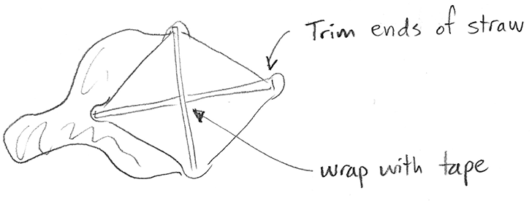
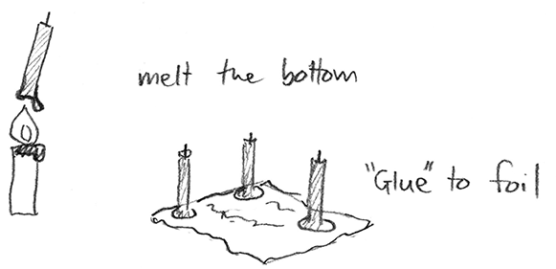
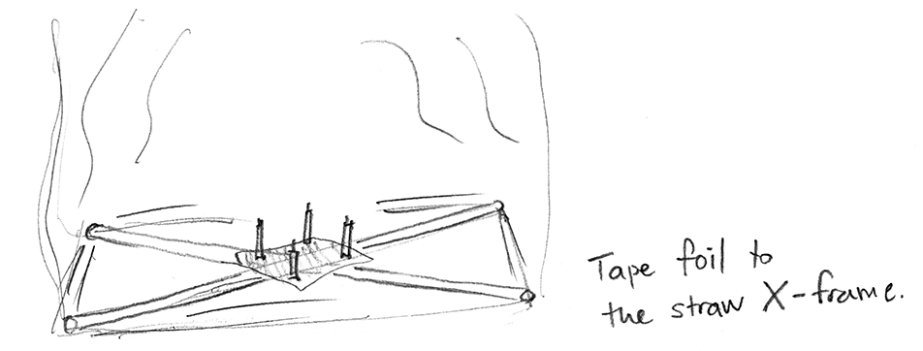
tape
Drinking straws & plastic bag
Birthday candles & foil
(3)
lighter
Make the struts into a cross.
Wrap center with tape
Trim the 4 ends of the cross.
It should fit snuggly in the opening of the bag.
try 5 short candles
With the cross in the bag,
tape the candle platform to the cross.

Slide 20
Molecular kinetics gas simulation module
Demo #10: Explain how the hot air balloon worked using the same PHET simulation. A small input of heat makes the air molecules move faster, fewer air molecules in the chamber needed to maintain atmospheric pressure.

Slide 21
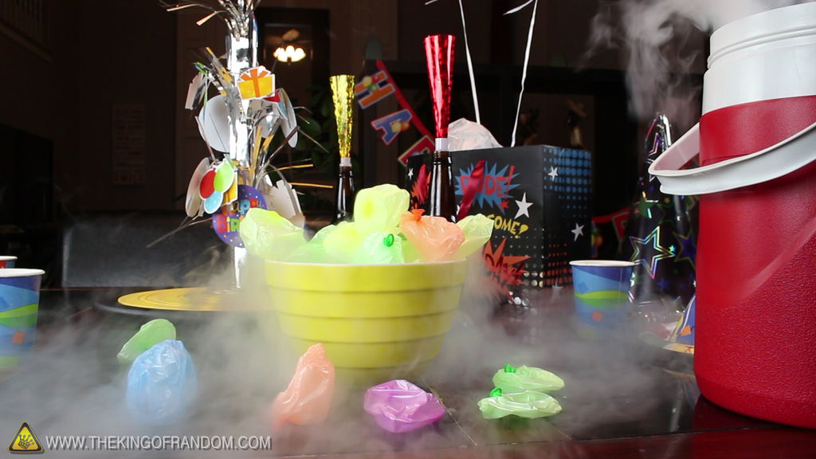
Every good theory makes a prediction…
If hot gas molecules fill more space…
cold gas molecules fill less space
-196°C
Demo #11: Kids inflate balloons (balloons must be filled with humid air), then balloons are put into a cooler that has liquid nitrogen. Remember, safety first! Kids need clear instructions about keeping themselves safe from LN2.
(typical freezer -18°C)

Slide 22
Beyond the physics of air
Physics (working definition for today):
Carefully observing how things move (things like atoms and planets…)
Asking how and why.
(Short lecture about how Physics informs philosophy)

Slide 23
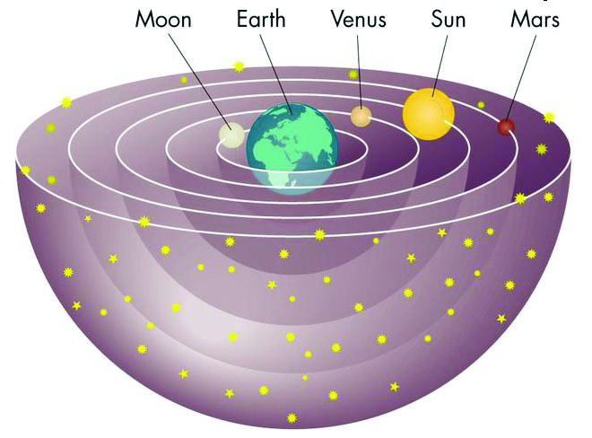
Example 1:
Earth-at-the-center-of-everything theory
(by carefully observing the trajectories of the planets, seeing that Venus and Mars travelled in “loop-the-loop” paths relative to earth, physicists understood that a more elegant explanation was that the earth was also making circular orbits)

Slide 24
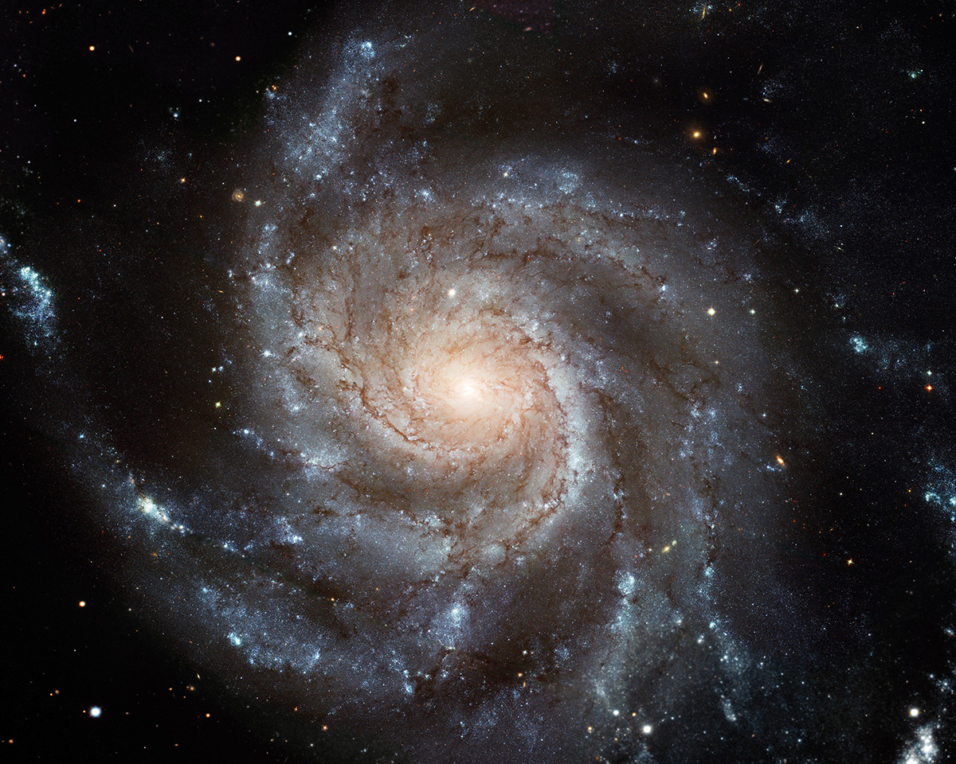
Earth-like-a-speck-of-dust theory
“Far out in the uncharted backwaters of the unfashionable end of the western spiral arm of the Galaxy lies a small unregarded yellow sun. Orbiting this at a distance of roughly ninety-two million miles is an utterly insignificant little blue green planet…”
Douglas Adams
http://vimeo.com/10099222
A star like our Sun
(The Hitchhiker’s Guide to the Galaxy)

Slide 25
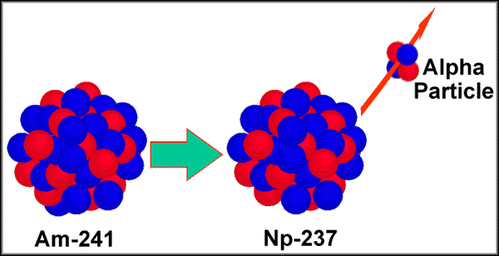
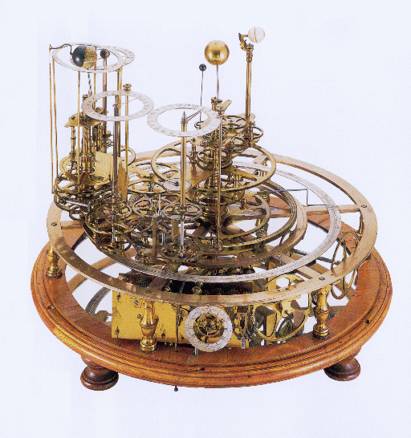
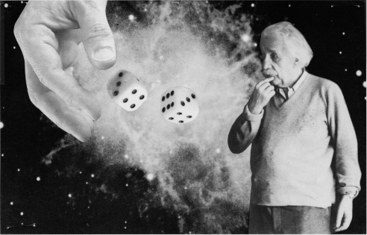
Example 2:
The microscopic world (quantum mechanics)
Observation of atoms
Quantum mechanics is probabilistic
Everything is a game of chance

Slide 26
Careful observation
Change the way people think about things

Slide 27
Final Exam
Consider gas molecules that are 2x heavier than surrounding air
and 3x hotter than surrounding air…
Up ?
C₃H₈
Down ?
Demo #12: The spectacular explosion at the end of the show. Involves 6” diameter soap bubbles filled with propane. Remember safety first! Kids need clear instructions where to stand.

Slide 28
Thanks for coming!
Line up in foyer for 1st-round of hover board rides
Come sit in the front rows if you’d like to ask questions (and get 2nd-round hover board rides)

